Slide 1
Linked Representation of Graphs
Md. Maskaowat Ahsan Hasby
Student ID: 2410876132
Dept. of Computer Science and Engineering
University of Rajshahi

Slide 2
Contents:
Introduction of Graphs
Linear Representation of a Graph
Breadth First Search (BFS)
Depth First Search (DFS)
Differences Between BFS and DFS

Slide 3
Introduction of Graphs
Definition
Memory Representations
Graphs:
A Graph G is a non-linear data structure defined by an ordered pair (V, E) where:
V (Vertices): A set of nodes representing data entities.
E (Edges): A set of connections between pairs of vertices.
Graphs represent pairwise relationships between objects (e.g., cities connected by roads).
1. Sequential Representation
Uses an Adjacency Matrix (2D Array). Good for dense graphs.
2. Linked Representation
Uses Adjacency Lists (Linked Lists). Good for sparse graphs.

Slide 4
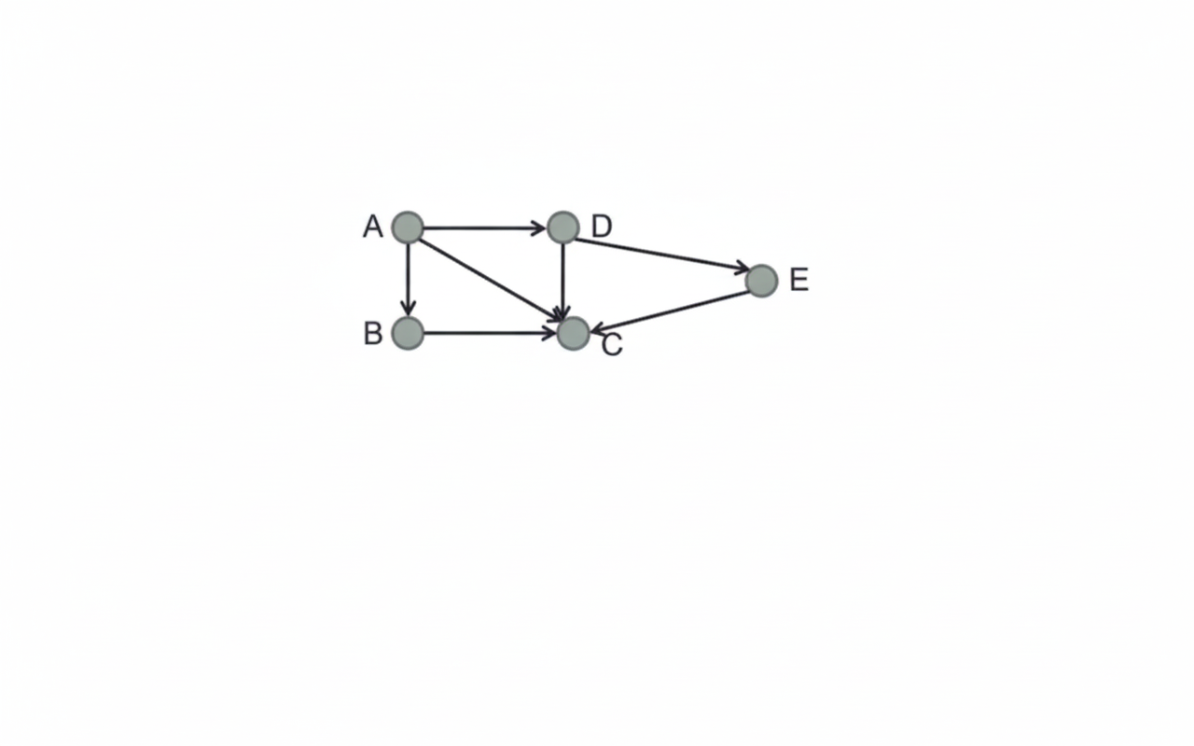
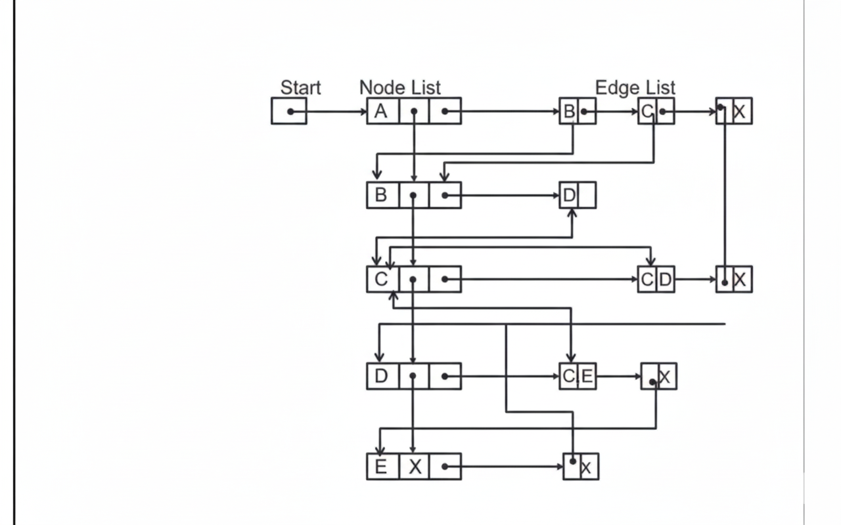
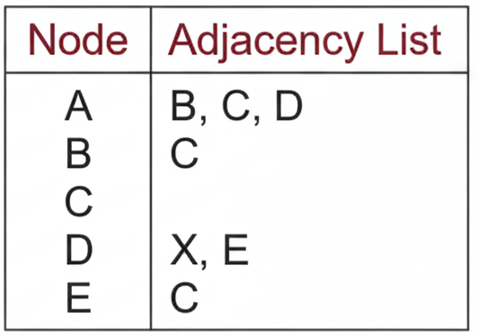
Linked Representation Overview
The Concept
In linked representation, each node in G is followed by its adjacency list.
This list contains all its "successors" or "neighbors".
This representation uses two specific lists:
Node list (NODE)
Edge list (EDGE)

Slide 5
Data Structure: The Node List, Edge List
Node List: Each element in the NODE list corresponds to a vertex in the graph.
It is a record containing three fields:
1. NODE: Name or key value of the node.
2. NEXT: Pointer to the next node in the list.
3. ADJ: Pointer to the first element in the adjacency list (maintained in EDGE list).
Node record structure below:
Edge List: Each element in the EDGE list corresponds to an edge of G.
It is a record containing two main fields:
1. DEST: Points to the location of the destination node in the NODE list.
2. LINK: Links together edges with the same initial node (the next neighbor).
Edge record structure below:
NODE | NEXT | ADJ | …
DEST | LINK | …
* Note: Records may also store INDEG, OUTDEG, or STATUS.
* Records may also store edge weights or labels.

Slide 6
Graph Traversal & Node States
There are two ways:
Breadth First Search (BFS): Uses a queue as an auxiliary structure to hold nodes for future processing.
Depth First Search (DFS): Uses a stack as an auxiliary structure.
During algorithms (BFS/DFS), each node N will be in one of three states:
1
Ready State
The initial state of Node N. (STATUS=1)
2
Waiting State
Node N is in the Queue or Stack, waiting to be processed. (STATUS=2)
3
Processed State
Node N has been fully processed. (STATUS=3)

Slide 7
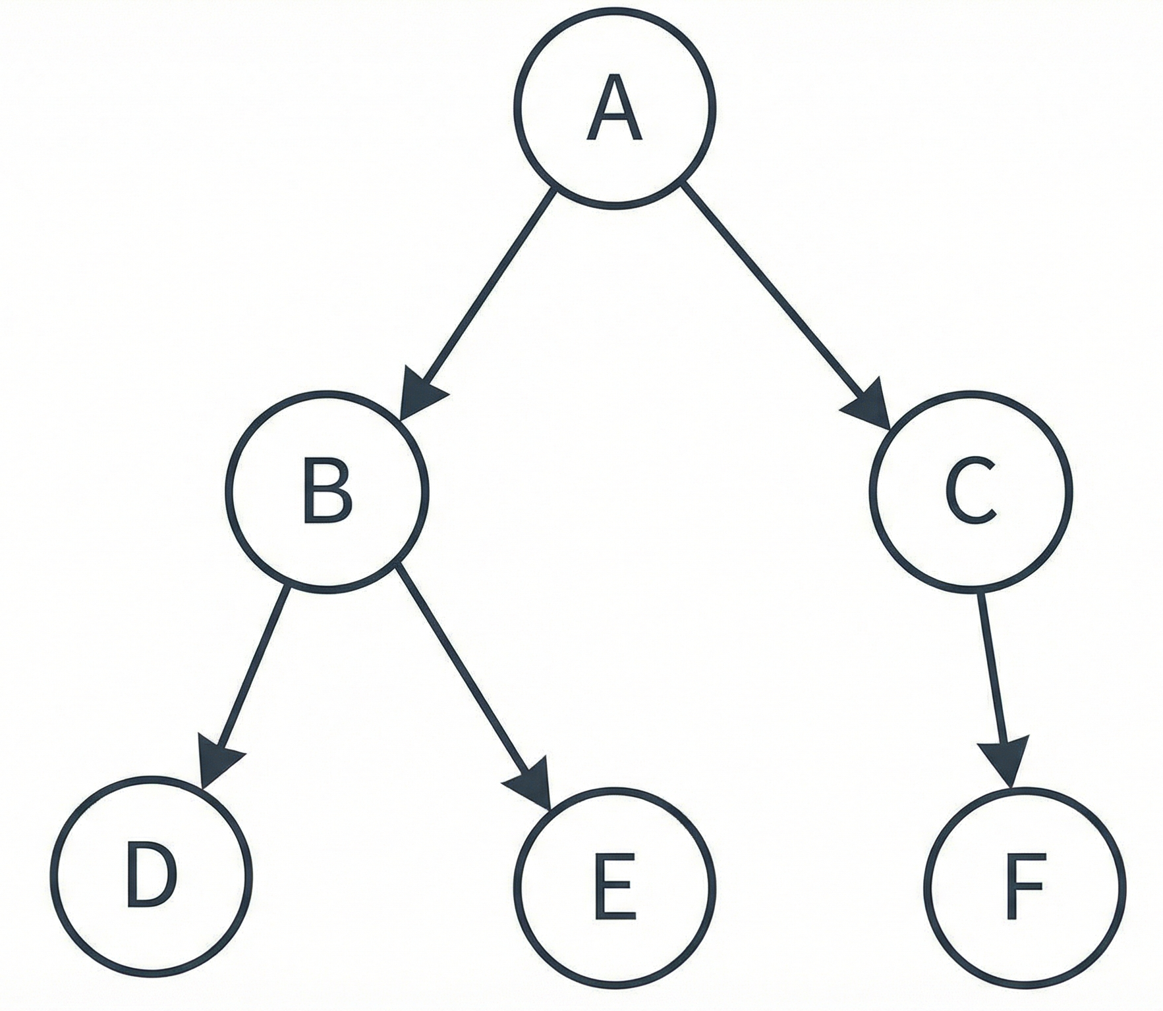
Breadth-First Search (BFS)
Algorithm Logic:
Initialize all nodes to Ready (1)
Put start node A in Queue and set to Waiting (2).
Repeat until Queue is empty:
Remove front node N. Process it. Set to Processed (3).
Add all neighbors of N that are Ready (1) to Queue and set them to Waiting (2).
Breadth-First Search

Slide 8
BFS Simulation Steps:
Step 3 : Dequeue and process node B
Dequeue B and process it.
Enqueue its unvisited neighbors: D and E.
Queue : [C, D, E]
Visited : {A, B, C, D, E}
Step 4 : Dequeue and process node C
Dequeue C and process it.
Enqueue its unvisited neighbor : F.
Queue : [D, E, F]
Visited : {A, B, C, D, E, F}
Step 5 : Process the remaining nodes
Continue dequeuing and processing nodes (D, E, F) until the queue is empty.
Initialization
Queue : Empty initially.
Visited Nodes : Start with only the source node marked as visited.
Step 1 : Enqueue the starting node
Enqueue node A.
Queue : [A]
Visited : {A}
Step 2: Dequeue and process node A
Dequeue A and process it.
Enqueue its unvisited neighbors : B and C.
Queue : [B, C]
Visited : {A, B, C}
Final Traversal Order : A → B → C → D → E → F

Slide 9
Depth-First Search (DFS)
Algorithm Logic:
Similar to BFS, but uses a Stack instead of a Queue.
Initialize all nodes to Ready (1)
Push start node A to Stack, set to Waiting (2).
Repeat until Stack is empty:
Pop top node N. Process it. Set to Processed (3).
Push neighbors of N that are Ready (1) to Stack, set to Waiting (2).
Depth-First Search

Slide 10
Here's the simulated Depth-First Search (DFS) on the provided graph:
DFS Simulation Steps:
Initialization: Stack: [], Visited: {}.
Start at A: Push A.
Stack: [A], Visited: {A}.
2. Process A, Move to B: Pop A. Push A's unvisited neighbors (e.g., C, then B). Pop B. Push B's unvisited neighbors (e.g., E, then D).
Stack: [C, D, E], Visited: {A, B, C, D, E}.
3. Process D: Pop D. D has no unvisited neighbors.
Stack: [C, E].
4. Process E: Pop E. E has no unvisited neighbors
Stack: [C].
5. Process C, Move to F: Pop C. Push C's unvisited neighbor (F).
Stack: [F], Visited: {A, B, C, D, E, F}.
6. Process F: Pop F. F has no unvisited neighbors.
Stack: [] (Empty).
Final DFS Traversal Order: A → B → D → E → C → F

Slide 11
Differences Between BFS and DFS
Feature | BFS (Breadth First Search) | DFS (Depth First Search)
Traversal Method | Level-by-level (horizontal movement | Depth-wise (vertical movement)
Data Structure | Queue | Stack / Recursion
Starting Node | Start from a source and explores neighbors first | Starts form a source and goes deep before backtracking
Uses | Shortest Path Finding, Cycle Detection, Connected Components, Network Routing | Detect cycles, path checking, topological sorting
Memory Usage | High (stores many nodes in queue) | Low (stores only path nodes)
Time Complexity | O(V + E) | O(V + E)
Space Complexity | O(V) | O(V)
Tree Produced | BFS Tree | DFS Tree
Nature or Search | Complete Search | Backtracking-based search

Slide 12
Thank You
For your patience

